Slide 1

Thank You
This PowerPoint document contains the images that you requested.
Copyright Notice
All materials on this Site are protected by United States copyright law and may not be reproduced, distributed, transmitted, displayed, or otherwise published without the prior written permission of Wolters Kluwer. You may not alter or remove any trademark, copyright or other notice.
However, provided that you maintain all copyright, trademark and other notices contained therein, you may download material (one machine readable copy and one print copy per page) for your personal, non-commercial use only. Please refer to this link for further information on how to apply for permission for re-use
Any information posted to discussion forums (moderated and un-moderated) is for informational purposes only. We are not responsible for the information or the result of its practice.

Slide 2
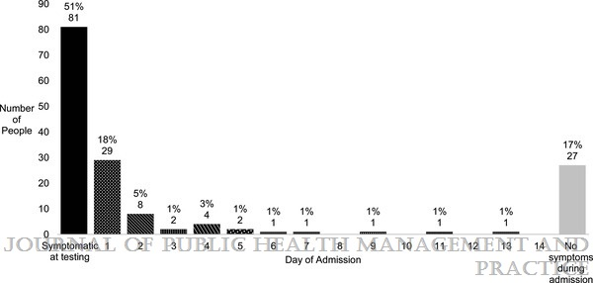
APPENDIX FIGURE
Establishment of Isolation and Noncongregate Hotels During COVID-19 and Symptom Evolution Among People Experiencing Homelessness—Atlanta, Georgia, 2020
Montgomery, Martha P.; Paulin, Heather N.; Morris, Asher; Cotton, Afrika; Speers, Austin; Boyd, Andrew T.; Buff, Ann M.; Mathews, Darlene; Wells, Alyssa; Marchman, Cathryn; Gaffga, Nicholas; Bamrah Morris, Sapna; Cavanaugh, Sean S.
Journal of Public Health Management and Practice27(3):285-294, May/June 2021.
doi: 10.1097/PHH.0000000000001349
Time From Admission to Symptom Onseta for 158 Clients Admitted to COVID-19 Isolation Hotel for at Least 7 Days, Atlanta, Georgia—April 10-September 1, 2020aMedian time from admission to symptom onset for 50 clients with symptoms first reported during admission was 1 day (interquartile range = 1-3 days; range, 1-13 days)

